Slide 1
Sales Performance Analysis of Walmart
Alen Peter

Slide 2
Introduction
Walmart, a leading global retail chain, generates massive volumes of transactional data across multiple branches and cities. This project leverages advanced SQL techniques to explore and analyze Walmart’s sales dataset in order to uncover actionable insights.
The analysis covers key areas such as:
Branch-wise sales growth
Profitability by product lines
Customer spending behavior and segmentation
Payment preferences across cities
Sales anomalies and trends by time
Tools:
MySQL for data analytics.
EXCEL Power Pivot for visualisation.
Changed column names and date formats for better analysis purposes.

Slide 3
Task1Identifying the Top Branch by Sales Growth Rate
WITH Monthly_Summary AS
(SELECT Branch, MONTHNAME(SalesDate) AS MonthName, DATE_FORMAT(SalesDate, '%Y-%m') AS YearMonth, SUM(Total) AS MonthlyTotal
FROM walmart
GROUP BY Branch, YearMonth, MonthName),
MonthlyGrowth AS (
SELECT Branch, MonthName, YearMonth, MonthlyTotal,
ROUND(((MonthlyTotal - LAG(MonthlyTotal) OVER (PARTITION BY Branch ORDER BY YearMonth)) / LAG(MonthlyTotal) OVER (PARTITION BY Branch ORDER BY YearMonth)) * 100, 2) AS GrowthRate
FROM Monthly_Summary),
AvgGrowthByMonth AS (
SELECT Branch, MonthName, ROUND(AVG(GrowthRate), 2) AS AvgGrowthRate
FROM MonthlyGrowth
WHERE GrowthRate is not null
GROUP BY Branch, MonthName)
SELECT *FROM AvgGrowthByMonth
ORDER BY Branch, MonthName;

Slide 4
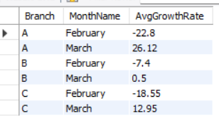
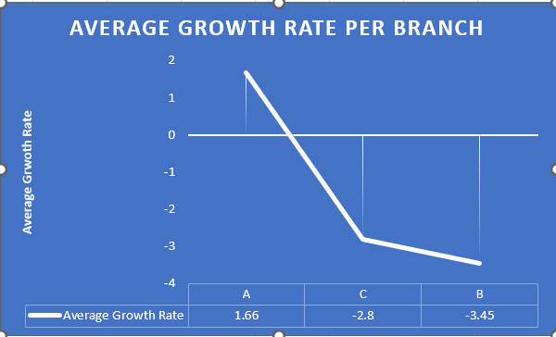

Slide 5
Task 2 Finding the Most Profitable Product Line for Each Branch
WITH ProfitByProduct AS (
SELECT Branch, Product_line, round(SUM(gross_income - cogs),2)
AS TotalProfit
FROM walmart
GROUP BY Branch, Product_line),
ranked_partition as (
select * ,
dense_rank() over (Partition by Branch order by TotalProfit Desc) as Grade
from ProfitByProduct)
select *
from ranked_partition
where Grade = 1;
Branch | Product_line | TotalProfit | Grade
A | Health and beauty | -11397.97 | 1
B | Food and beverages | -13765.85 | 1
C | Home and lifestyle | -12572.17 | 1

Slide 6
Insights
Branch A (Health & Beauty): Loss of $11,397.97 (Grade I)
Branch C (Home & Lifestyle): Loss of $12,572.17 (Grade I)
Pricing may not cover costs
High inventory or supplier gross_income - cogs = very negative value, because of subtracting a large number (cogs) from a small one (gross_income).
Potential shrinkage or low turnover

Slide 7
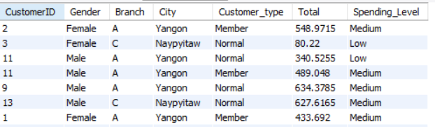
Task 3: Analyzing Customer Segmentation Based on Spending
SELECT CustomerID, Gender, Branch, City, Customer_type, Total,
CASE
  WHEN Total < 400 THEN 'Low'
  WHEN Total BETWEEN 400 AND 800 THEN 'Medium'
  ELSE 'High'
END AS Spending_Level
FROM walmart;

Slide 8
Task 4: Detecting Anomalies in Sales Transactions
WITH Stats AS (
SELECT Product_line, AVG(Total) AS avg_total, STDDEV(Total) AS std_total
FROM walmart
GROUP BY Product_line),
Flagged AS (
SELECT w.*, s.avg_total, s.std_total,
CASE
WHEN w.Total >= s.avg_total + 1.5 * s.std_total THEN 'High Anomaly'
WHEN w.Total <= s.avg_total - 1.5 * s.std_total THEN 'Low Anomaly'
ELSE 'Normal'
END AS AnomalyFlag
FROM walmart w
JOIN Stats s ON w.Product_line = s.Product_line)
SELECT Product_line, Branch, Round(avg_total,2), round(std_total,2), AnomalyFlag
FROM Flagged;

Slide 9
Calculated average and standard deviation of Total sales for each product line.
Flagged transactions as: High Anomaly: Total > =AVG + 1.5 × STD
Low Anomaly: Total <= AVG - 1.5 × STD
Visualized anomalies using a horizontal bar chart by product line.

Slide 10
Insights:
Product lines such as Home and lifestyle, Food and Beverages and Electronic Accessories displayed a higher concentration of high anomalies.
Product lines like Health and Beauty, Fashion accessories, Sports and Travel showed fewer high anomalies, suggesting more consistent and predictable transaction patterns.
Leveraging a 1.5 standard deviation threshold enabled the identification of moderate anomalies while reducing false positives, making this approach practical for business monitoring.
Implications
Product lines with frequent high anomalies may require stock level reviews or restocking strategies.
Unusual transaction patterns can help in identifying possible misuse or irregular purchasing behavior.
High anomalies concentrated around specific product lines could be linked to seasonal offers or pricing strategies that require further evaluation.

Slide 11
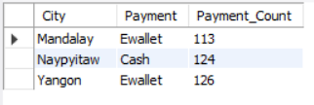
Task 5: Most Popular Payment Method by City
with payment_count as (
select City, Payment, count(payment) as Payment_Count
from walmart
Group by City, Payment),
rank_payment as (
select * , dense_rank() over ( partition by City order by Payment_Count Desc) as Rank_Payment
from payment_count)
select City, Payment, Payment_Count
from rank_payment
where Rank_Payment = 1;

Slide 12
Insights
Yangon:
  Ewallet is the most popular method with 126 transactions, followed by Cash (110) and Credit Card (104).
  Digital payments dominate, indicating high tech adoption in this city.
Naypyitaw:
  Cash leads with 124 transactions, significantly higher than Ewallet (106) and Credit Card (98).
  Suggests a preference for traditional payments, possibly due to lower digital penetration.
Mandalay:
  Ewallet (113) slightly leads over Cash (110) and Credit Card (109), showing balanced usage of all payment types.
  Could reflect a transitional phase between traditional and digital methods.

Slide 13
Task 6: Monthly Sales Distribution by Gender
with monthlysales as (
select Gender, Customer_type,monthname(SalesDate) as Months,
round(sum(Total), 2) as TotalSales,
count(Total) as TranscationCount,
round(avg(Total),2) as Avg_Transaction
from Walmart
group by Gender, Months, Customer_type)
select Months,Gender,Customer_type,TotalSales,TranscationCount,Avg_Transaction,
round(TotalSales/Sum(TotalSales) over (partition by Months) * 100, 1) as SalesPercentage
from monthlysales
order by Months, Gender, Customer_type;

Slide 14
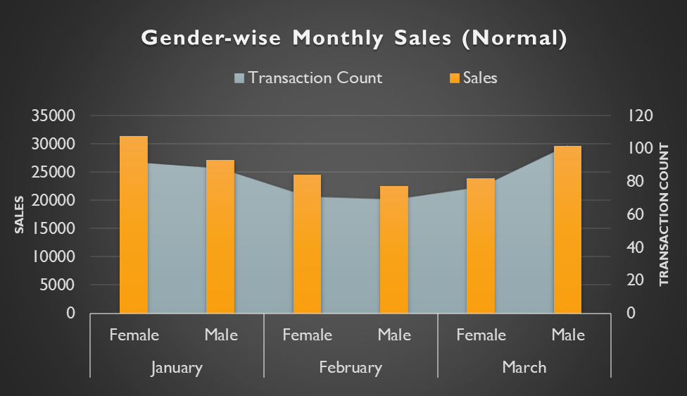
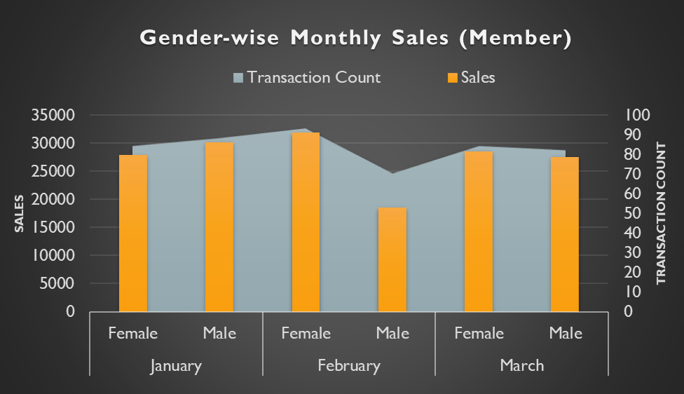
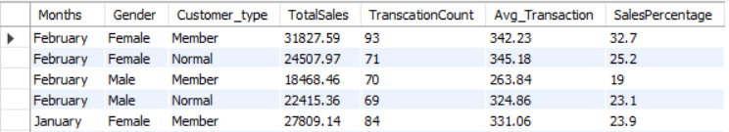
Insights
Female Normal customers had the highest sales percentage in January.
Member customers consistently show higher sales percentages than normal customers.
Normal customer transactions among Males increased in March.
Female Normal customers appear to spend more per transaction, making them a valuable customer segment.

Slide 15

Task 7 Best Product Line by Customer Type
with productsale as (
Select Customer_type, Product_line, sum(Total) as TotalSales
from Walmart
group by Customer_type, Product_line),
rankproducts as (select * ,
Dense_rank () over (partition by Customer_type order by TotalSales Desc) as Rank_ProductLine
from productsale)
select Customer_type, Product_line, Round(TotalSales,2) as Sales
from rankproducts
where Rank_ProductLine = 1;

Slide 16
Insights
Members spent the most on Food and Beverages, indicating a preference for essential or frequently purchased items.
Normal customers preferred Electronic Accessories, suggesting interest in occasional or higher-value tech-related purchases.
Walmart can use these insights to:
  Promote loyalty offers on food items for members.
  Target electronic deals to attract or convert normal customers into members.

Slide 17
Task 8: Identifying Repeat Customers
with Repeatdate as(
select a.CustomerID, a.SalesDate as FirstPurchase, b.SalesDate as RpeatPurchase,
Datediff(b.SalesDate, a.SalesDate) as DaysBetween
From walmart a
join walmart b on a.CustomerID = b.CustomerID
and b.SalesDate > a.SalesDate
and datediff( b.SalesDate, a.SalesDate) <= 30),
CustomerSales as (
select CustomerID, Round(sum(Total),2) as TotalSales, count(InvoiceID) as PurchaseCount
from Walmart
group by CustomerID)
Select distinct r.CustomerID, cs.TotalSales, cs.PurchaseCount
from Repeatdate r
join CustomerSales cs on r.CustomerID = cs.CustomerID
Order by PurchaseCount desc;

Slide 18
Insights
Most repeat customers made a similar number of purchases, but sales amounts vary, showing differences in spending habits.
Some customers with fewer purchases still contributed high sales, indicating bulk or high-value buys.
Repeat customers show consistent buying and strong sales potential. Walmart can target them with loyalty or personalized offers.

Slide 19
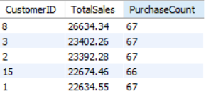
Task 9: Finding Top 5 Customers by Sales Volume
select distinct CustomerID,
Round(sum(Total),2) as TotalSales,
count(InvoiceID) as PurchaseCount
from walmart
group by CustomerID
order by TotalSales Desc
limit 5;

Slide 20
Insights:
High spend doesn’t always mean high frequency.
Customer 8 is the top spender and ideal for loyalty rewards.
Walmart can focus on spend quality over transaction count for rewards.

Slide 21
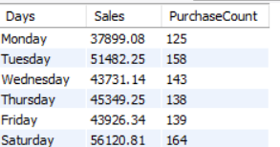
Task 10: Analyzing Sales Trends by Day of the Week
select dayname(SalesDate) as Days,
round(sum(Total),2) as Sales,
count(InvoiceID) as PurchaseCount
from Walmart
group by Days
order by field(Days, 'Monday','Tuesday','Wednesday', 'Thursday', 'Friday', 'Saturday','Sunday');

Slide 22
Insights:
Saturday had the highest sales and purchase count.
Tuesday also performed well, indicating strong midweek activity.
Monday had the lowest performance, suggesting room for improvement.
Overall, weekends drive more sales, making them ideal for promotions.

Slide 23
Q&A
Video link:
https://drive.google.com/file/d/143VHRgwv0ER5-WqPDDgjOTBOu6mezv2S/view?usp=sharing

